Slide 1
﻿Fully hardware implemented memristor convolutional neural network
﻿Peng Yao, Huaqiang Wu, Bin Gao, Jianshi Tang , Qingtian Zhang, Wenqiang Zhang J. Joshua Yang & He Qian

Slide 2
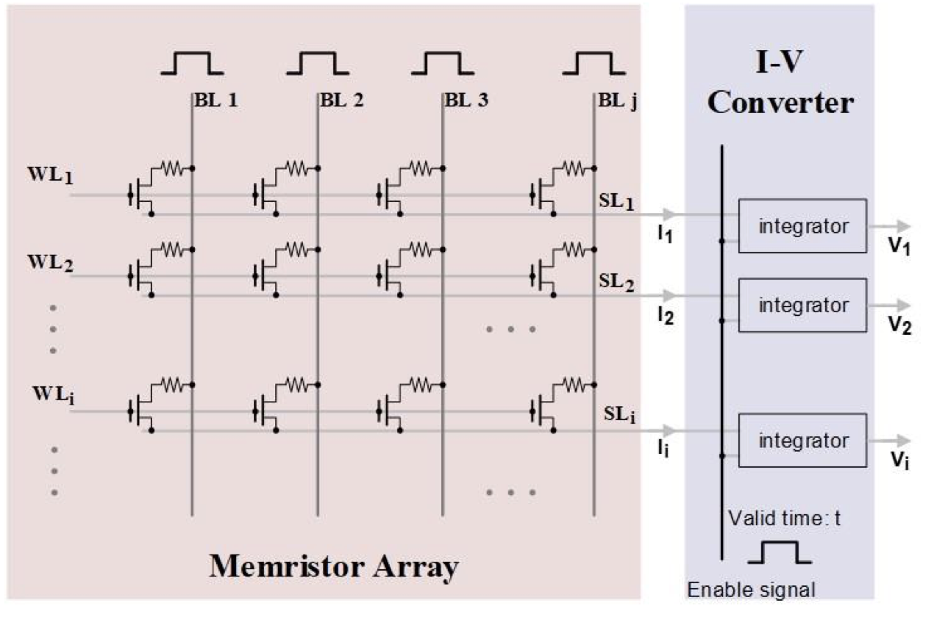
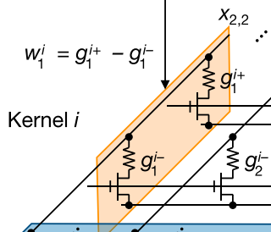
Memristor Cell
The weights are stored in the memristor array. When the input signal passes through the memristor array, the weighted sum is calculated.
In this article, the weight is represented by a pair of differential memristor
Notes:
﻿multi-level conductance states.
The parallel MAC results in the memristor array block are represented by currents, which subsequently flow into the I-V converter block and are transformed to voltage form by the integrators. The voltage signals are then quantized by the following ADC block.

Slide 3
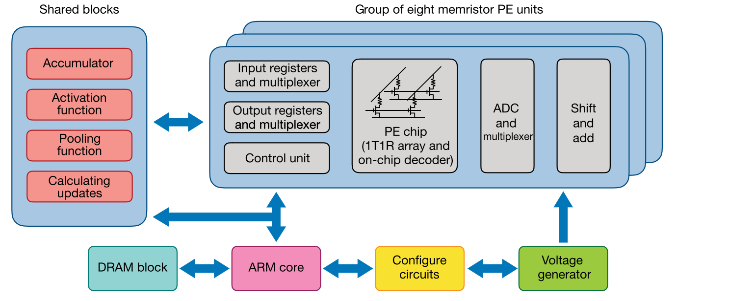
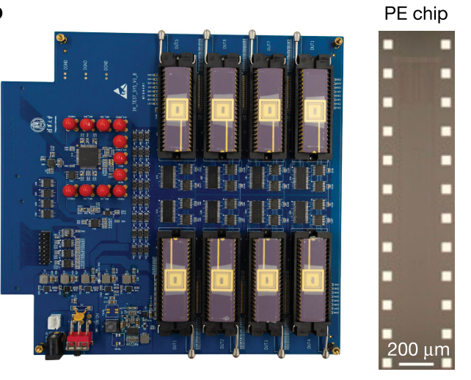
Architecture
The ﻿system architecture has eight integrated memristor PE units and other functional blocks. DRAM, dynamic random-access memory; ARM core, control unit with ARM (Acorn RISC Machine) architecture.
Each PE units has 16x128 memristor cells.

Slide 4
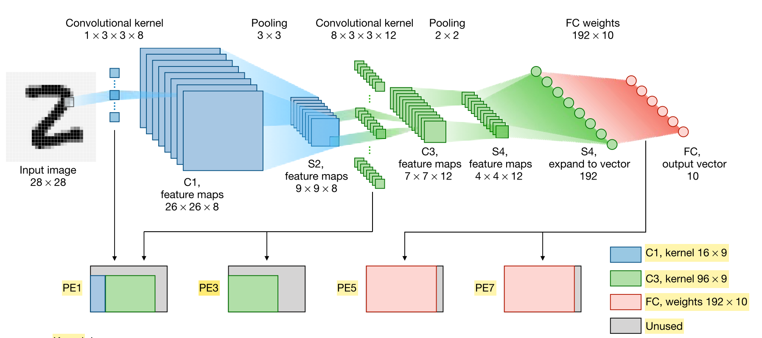
mCNN
mCNN has five layers used for MNIST image recognition, with alternating convolutional (C1, C3) and subsampling (S2, S4) layers and a FC layer.

Slide 5
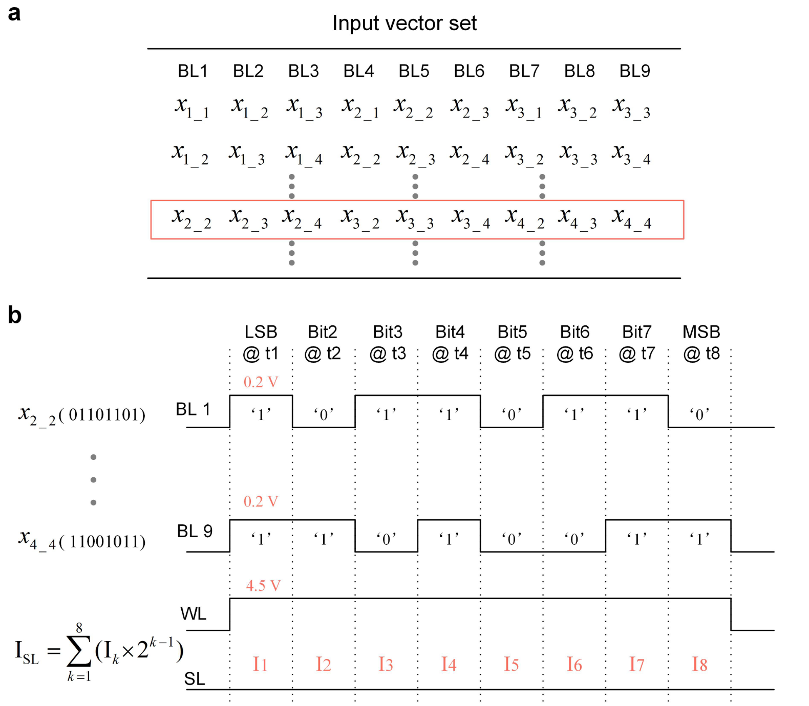
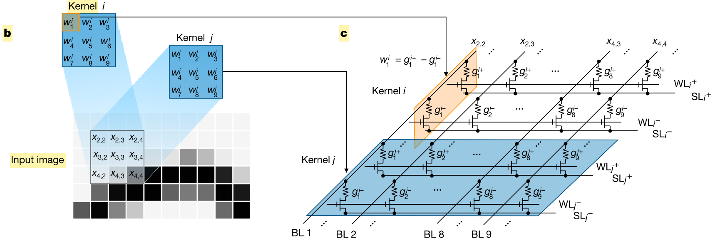
Convolution
﻿Each element (an 8-bit binary number) in the input vector is encoded as sequential pulses over eight time intervals
A signed kernel weight is mapped to the differential conductance of a pair of memristors
The difference between every
two ISL values from a pair of differential source lines are considered to be the expected weighted-sum result.
Notes:
﻿Each element (an 8-bit binary number) in the input vector is encoded as sequential pulses over eight time intervals (t1, t2, …, t8). For a particular period tk, bit k determines whether a 0-Vpulse or a 0.2-V pulse is used. Each ‘1’ at a certain bit location implies the existence of a 0.2-V read pulse in the corresponding time interval, and a ‘0’ indicates a 0-V read pulse. The corresponding output current Ik is sensed, andthis quantized value is then left-shifted by k – 1. Finally, the quantized and shifted results with respect to the same source line over the eight time intervals are summed together (ISL in the inset equation). The difference between every
two ISL values from a pair of differential source lines is considered to be the expected weighted-sum result.
﻿The input value is encoded by the pulse number according to its quantized bit number (Extended Data Fig. 2). A signed kernel weight is mapped to the differential conductance of a pair of memristors. In this manner, all the weights of a kernel are mapped to two conductance rows: one row for positive weights with positive pulse inputs and the other for negative weights with equivalent negative pulse inputs. After inputting the encoded pulses into the bit lines, the output currents through the two differential source lines are sensed and accumulated. The differential current is the weighted sum corresponding to the input patch and the chosen kernel. Different kernels with different weights are mapped to different pairs of differential rows, and the entire memristor array operates MACs in parallel under the same inputs. All the desired weighted-sum results are obtained concurrently

Slide 6
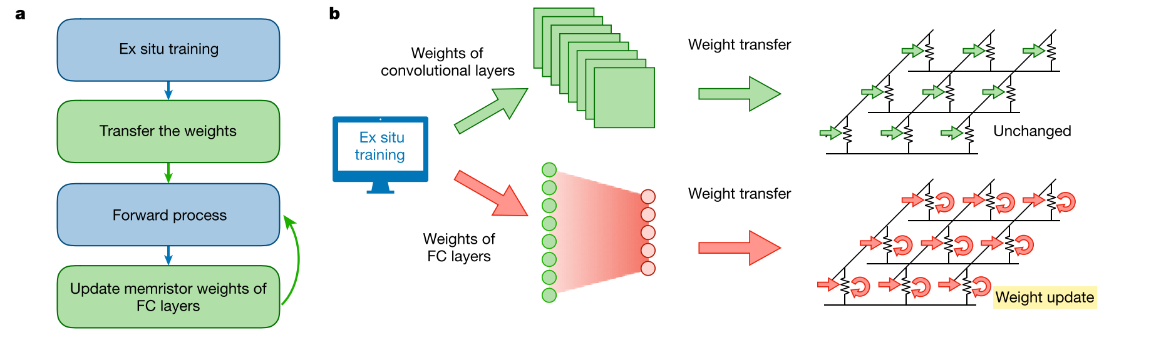
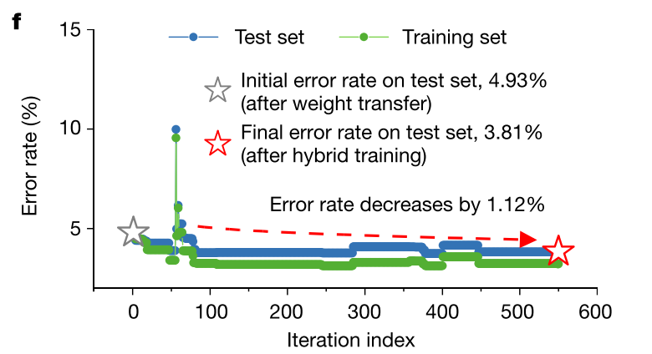
Hybrid training
The recognition accuracy dropped from ﻿97.99% to 95.63% owing to the non-ideal memristor characteristics after transferring the weights from Python to memristor array.
﻿Tuning the FC conductance weights only is the most efficient for regaining a remarkable generalization result.
﻿First a CNN model is trained ex situ, and then all the determined weights are transferred to the memristor PEs. In the next step, the external input propagates forwards through the mCNN, and only the last fully connected (FC) layer is trained in situ afterwards to tune the memristor conductance.
Notes:
﻿We trained the five-layer CNN model in Python and reached 97.99% recognition accuracy on the test set. The extracted memristor compact model was then used to validate that in situ learning of the FC conductance weights is generally adequate for tolerating device imperfections. After transferring the weights, the recognition accuracy dropped from ﻿97.99% to 95.63% owing to the non-ideal memristor characteristics.

Slide 7
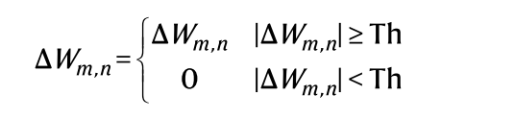
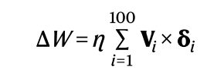
In situ training
﻿100 images drawn from the 55,000 training images were fed into the mCNN and processed from the initial to the final output layer
﻿The gradients of the objective function with respect to the FC weighted-sum outputs were determined using the softmax probabilities and the associated true image labels.
The quantitative updates of the FC weights were calculated from the intermediate FC inputs and the gradients as follows:
﻿η : learning rate, is a constant;
ΔW : desired updates of the weight matrix;
Vi : the intermediate 192-dimensional column vector injected into the FC layer;
δi : the calculated ten-dimensional row vector representing the objective derivatives of the FC outputs;
﻿ ﻿The accumulated weight updates determine the conductance changes that are ultimately needed on the basis of the following threshold learning rule
﻿This threshold learning rule tends to reduce the number of programming operations by filtering out the original tiny updates, and results in training acceleration and energy saving.
Notes:
﻿Here, the learning rate η is a constant; ΔW describes the desired updates of the weight matrix; Vi is the intermediate 192-dimensional column vector injected into the FC layer; δiis the calculated ten-dimensional row vector representing the objective derivatives of the FC outputs; and i represents the image index in the batch of 100 images.

Slide 8
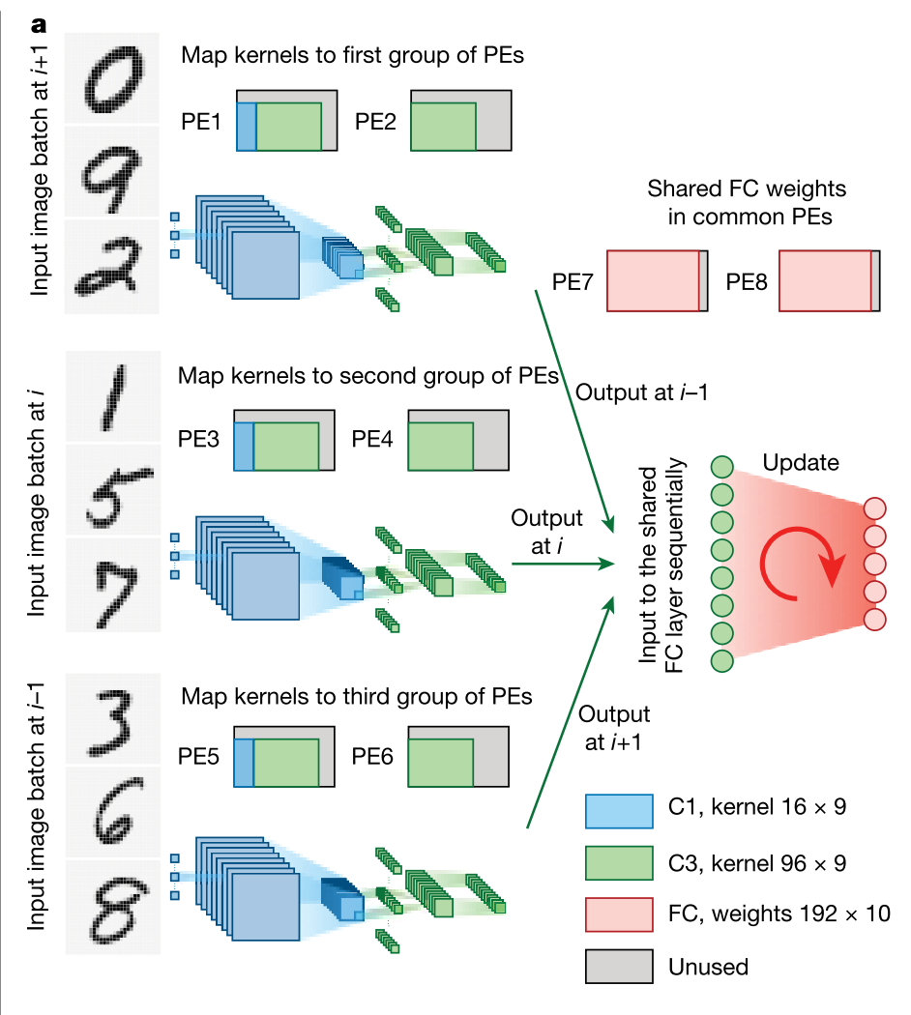
In situ training
Three groups are organized as the input to the FC layer in a pipeline fashion. A batch of intermediate outputs will not be supplied as input until the previous batch has been used to calculate the desired weight updates and the corresponding FC memristor conductances have been well tuned.
Notes:
﻿ Sketch of the hardware system operation flow with hybrid training used to accommodate non-ideal device characteristics for parallel memristor convolvers. Three batches of input images (handwritten digits on the left) are fed into three PE convolver groups. All the processed intermediate data are fed into the shared FC PEs to complete the in situ tuning. In the neural network schematic, the blue part represents convolutional layer C1 and subsampling layer S2, and the green part represents convolutional layer C3 and subsampling layer S4. In the PE diagram, the blue region represents the kernels of the C1 layer and the green region represents the kernels of C3 layer.
b–d,
﻿organized them as the input to the FC layer in a pipeline fashion. The training scheme sets the constraint that a batch of intermediate outputs will not be supplied as input until the previous batch has been used to cal- culate the desired weight updates and the corresponding FC memristor conductances have been well tuned. The desired updates of the FC weights with respect to the first input batch were calculated according to equation (1), and the relevant memristor conductances were modu- lated following the threshold learning rule of equation (2). Then, the FC conductances were updated after inputting the second input batch based on the well tuned FC weights of the previous phase. Afterwards, the third batch was used to tune the FC conductance weights sequen- tially. During this updating stage, another three batches were drawn from the training database and fed into the unoccupied memristor convolvers in parallel. These operations were repeated until the system converged to a stable recognition accuracy.
Benchmarking

Slide 9
Quantization
﻿A 4-bit weight is generally sufficient to achieve a high recognition accuracy for CNN.
In this work, an approximate 15-level fixed-point weight was adopted as the differential conductance of a pair of 8-level memristors. ﻿The quantization of
the 15-level fixed point relaxed the conductance mapping requirements to speed up weight transfer, and ensured a high recognition accuracy of 96.92%.
Notes:
. The smaller number of conductance states needed within the switching window leads to faster weight transfer because a larger target margin is permitted in the closed-loop writing

Slide 10
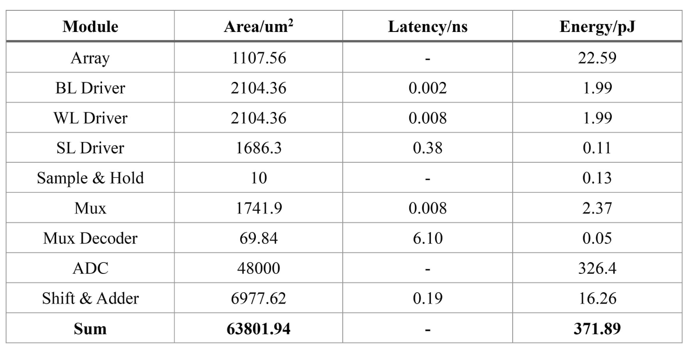
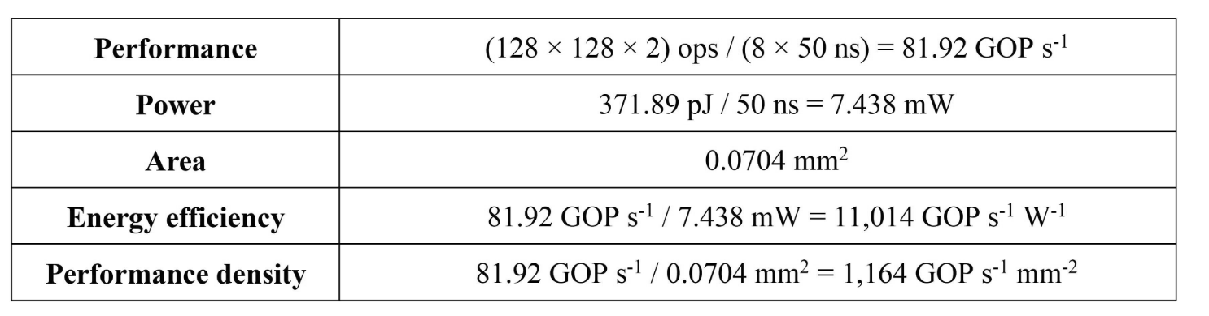
Evaluation
﻿The experimental results show that hybrid training could boost the recognition accuracy on the 10,000 test images from 93.86% to 95.83%.
The performance benchmark of the memristor-based computing system shows 110 times better energy efficiency ﻿(11,014 GOP s⁻¹ W⁻¹ 1 GOP = 10⁹ operations) and 30 times better performance density (﻿1,164 GOP s⁻¹ mm⁻²) compared with Tesla V100 GPU.
The tables are detailed metrics of each circuitry module in the macro core with 1-bit input and ﻿Benchmark metrics of a single macro core with 8-bit input
Notes:
整个数字信道化的过程就是多想滤波加FFT处理

